Slide 1


FULL STACK WEB DEVELOPMENT WITH DJANGO
Lecture 8

Slide 2

Today’s Agenda
Developing Our Django App
Passing Data To Templates
Concept Of Template Variable
Example

Slide 3
Passing Data To Templates
We can also pass values to our template using the concept of template variables.
These template variables will allow us to inject content into the HTML directly from Views.
And later we can use Python code to inject content from a database!

Slide 4
Passing Data To Templates
Syntax:
A variable looks like this: {{variable}}.
The template replaces the {{variable}} by the actual variable sent by the view in the third parameter ( called context ) of the render() function.
The only point to remember is that this variable has to be passed as a key-value pair from view because templates receive these variables inside a dictionary.

Slide 5
Example
Suppose this is our HTML file called hello.html
<html>
<body>
Hello World!!!<br>
Good Morning From {{ name }}
</body>
</html>
Now our view will change to −
def hello(request):
myname= "Sachin"
return render(request, "hello.html", {"name" : myname})
The output we will get is:
Hello World!!!
Good Morning From Sachin

Slide 6

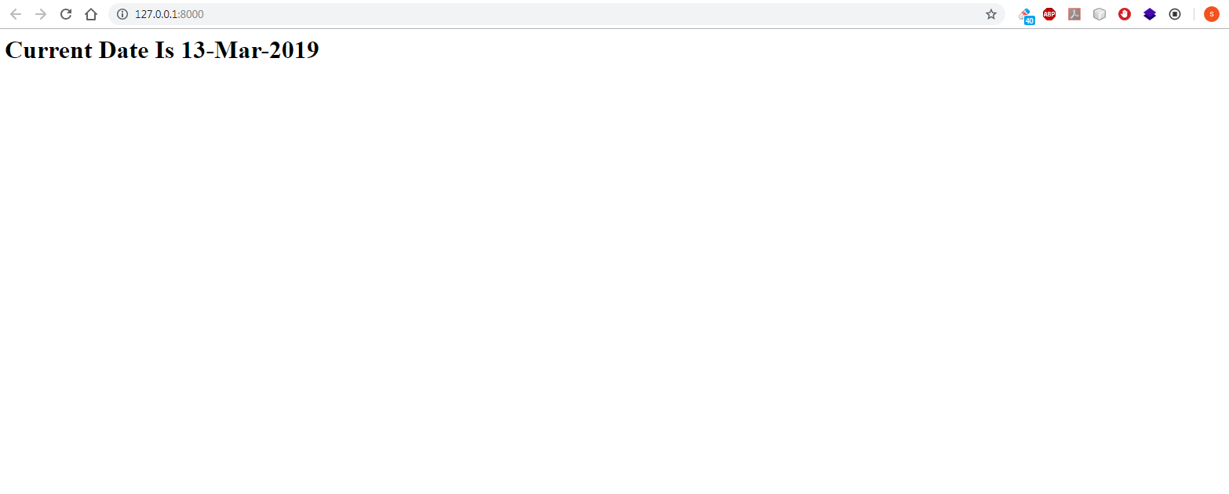
Exercise
Write a Django App using templates which displays current date as the user opens the home page
Output:

Slide 7
Solution
As usual we will first have to setup VS Code and create the project and app as follows:
Create a folder called myfourthvsdjangoproject inside djangoexamples
Open VS Code and open the folder myfourthvsdjangoproject in it
Open the command palette and new terminal to activate django virtual environment called vsdjango
Now create a project called templateproject2 using the usual command django-admin startproject templateproject2
Then create the app by using the command django-admin startapp templateapp2
Create a folder called templates in the root folder templateproject2 and within templates create a folder called templateapp2

Slide 8
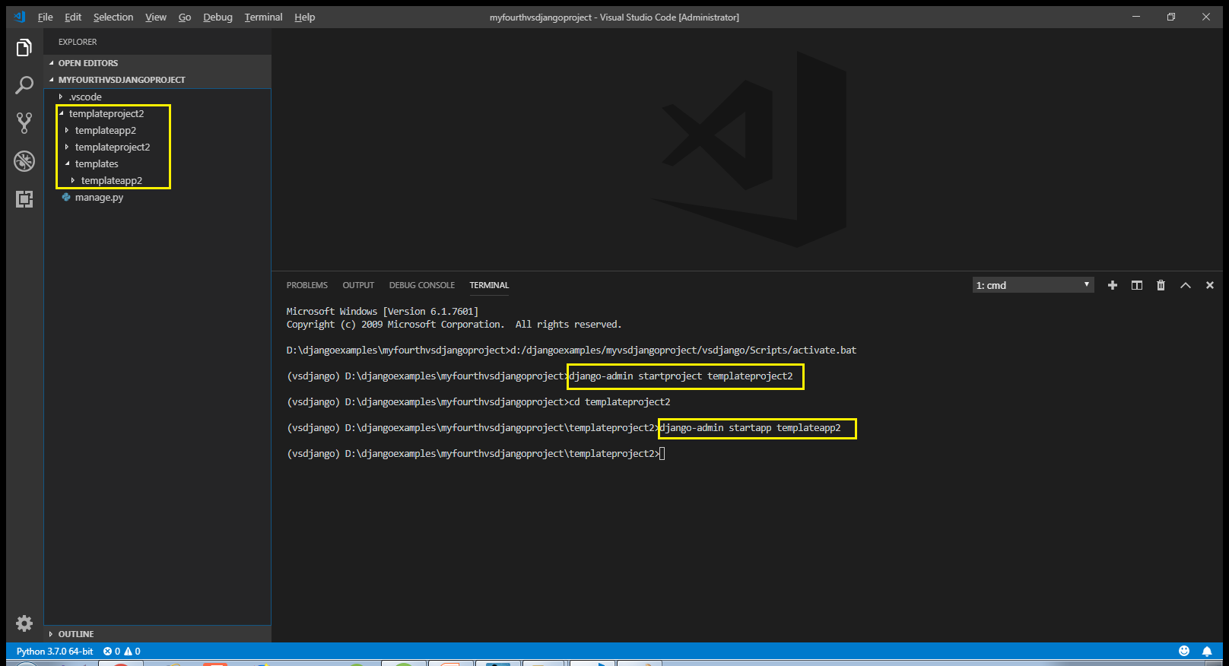
Solution

Slide 9
Solution
After doing all the initial setup in VS Code , the next task is to update the settings.py file by making 2 entries:
Entry for the app in the INSTALLED APPS list
Entry for the template directory in DIR key of TEMPLATES

Slide 10
Solution
Open the settings.py file in the templateproject2 app of our templateproject2 folder and make the entry shown in green color in the INSTALLED_APPS list
Code:
INSTALLED_APPS = [
'django.contrib.admin',
'django.contrib.auth',
'django.contrib.contenttypes',
'django.contrib.sessions',
'django.contrib.messages',
'django.contrib.staticfiles',
‘templateapp2',
]

Slide 11
Solution
In the settings.py of templateproject2 app locate the TEMPLATES list and modify it’s DIR key as shown below:
TEMPLATES = [
{ ...
'DIRS': [os.path.join(BASE_DIR, 'templates')],
... },
]

Slide 12
Solution
Once we’ve done creating templates folder structure then we can create an html file called showdate.html inside of the templates/templateapp2 directory.
This file should contain a template variable called today

Slide 13
Solution
#showdate.html
<!DOCTYPE html>
<html lang="en">
<head>
<meta charset="UTF-8">
<meta name="viewport" content="width=device-width, initial-scale=1.0">
<meta http-equiv="X-UA-Compatible" content="ie=edge">
<title>Template Variable Demo</title>
</head>
<body>
<h1>Current Date Is {{today}} </h1>
</body>
</html>

Slide 14
Solution
Now we have the template in place, we need to update our views.py.
In our views.py file , we must create a datetime object and extract current date from it .
Then we should call the render() function passing it 3 arguments:
Request object
Template file path
String representing current date
Make sure that we pass the third argument as a dictionary with the key as today and it’s value as current date

Slide 15
Solution
from django.shortcuts import render
from datetime import *
def homePageView(request):
curr_date=datetime.now()
curr_date_str=curr_date.strftime("%d-%b-%Y")
return render(request,"templateapp2/showdate.html",
{'today':curr_date})

Slide 16
Solution
After creating and updating the views.py we need to tell Django this is the view we want displayed when someone navigates to the site root (home page).
As usual we do this by configuring our URLs at 2 places:
Inside the templateapp2 directory’s urls.py file
Inside the site’s main urls.py

Slide 17
Solution
In the VS Code create a new file called urls.py in the templateapp2 folder and write the following code in it.
Code (templateapp2/urls.py):
from django.urls import path
from . import views
urlpatterns = [
path('', views.homePageView, name ='index'),
]

Slide 18
Solution
As we know whenever a request arrives it first hits the main urls.py file , that is , the file urls.py in the directory templateproject2.
So we must configure this file also so that it simply redirects the request to our templateapp2’s urls.py file whenever a request arrives

Slide 19
Solution
In the VS Code open the file called urls.py in the templateproject2 folder and update the code in it as shown below in green.
Code (templateproject/urls.py):
from django.contrib import admin
from django.urls import path,include
urlpatterns = [
path('admin/', admin.site.urls),
path('',include('templateapp2.urls')),
]

Slide 20
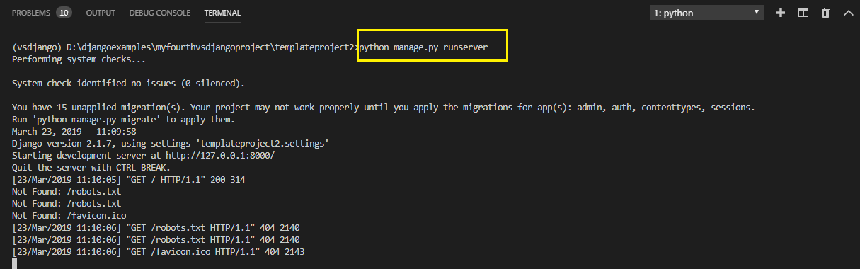
Solution
To run our new templateapp2 , go to the folder templateproject2 by using cd command and type the runserver command in VS Code terminal
cd templateproject2
python manage.py runserver.
The server runs on the default port 8000, and we’ll see output like the following output in the terminal window:

Slide 21
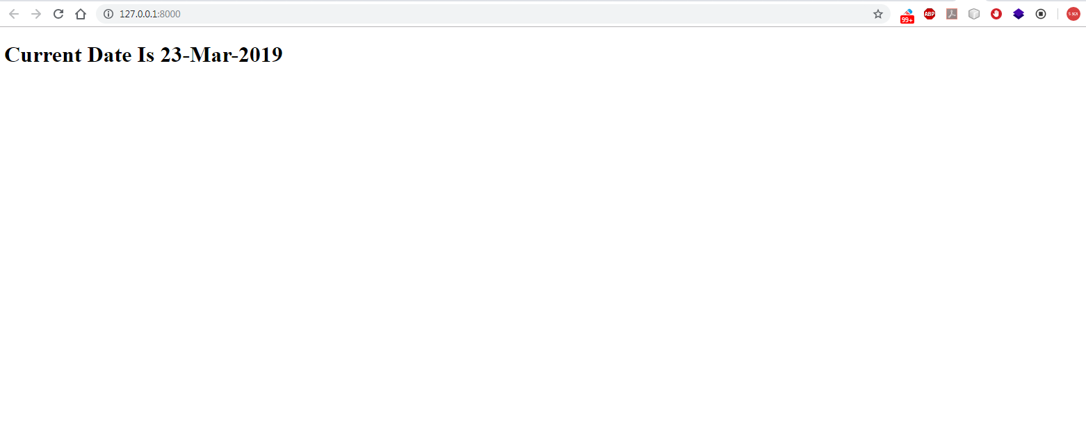
Solution
Ctrl+click the http://127.0.0.1:8000/ URL in the terminal output window to open default browser to that address. Now we should see the current date as a template based home page

Slide 22
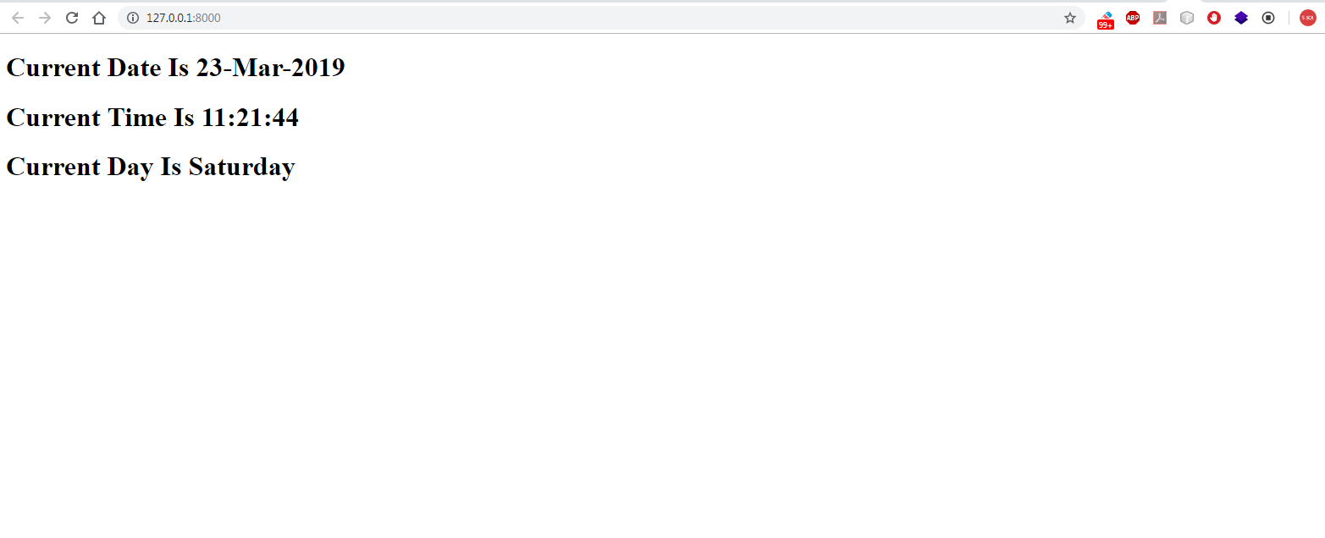
Exercise
Modify the previous exercise , so that now your page displays three information Current Date , Current Time and Current Day.
Output:

Slide 23
Solution
Everything will remain same except 2 changes
We will have to update the view so that it now sends three values to the template
In the HTML file we will have to use three template variable tags to retrieve the values sent by the view

Slide 24
Solution (views.py)
from django.shortcuts import render
from datetime import *
def homePageView(request):
curr_date=datetime.now()
curr_date_str=curr_date.strftime("%d-%b-%Y")
curr_time_str=curr_date.strftime("%H:%M:%S")
curr_day_str=curr_date.strftime("%A")
my_dict={'cdate':curr_date_str,'ctime':curr_time_str,'day':curr_day_str}
return render(request,"templateapp2/showdate.html",my_dict)

Slide 25
Solution(showdate.html)
<!DOCTYPE html>
<html lang="en">
<head>
<meta charset="UTF-8">
<meta name="viewport" content="width=device-width, initial-scale=1.0">
<meta http-equiv="X-UA-Compatible" content="ie=edge">
<title>Template Variable Demo</title>
</head>
<body>
<h1>Current Date Is {{cdate}} </h1>
<h1>Current Time Is {{ctime}} </h1>
<h1>Current Day Is {{cday}} </h1>
</body>
</html>

